Slide 1

Intro to CS

Slide 2
Homework
Review:

Slide 3
Hot & Cold
Preview:

Slide 4
#1 - Think
What does this program need to do?
Test sets

Slide 5
Hot & Cold test sets
Discuss:

Slide 6
#2 - Write
Pseudo-code
Max(a, b):
Is a > b? Return a
Otherwise? Return b

Slide 7
Hot & Cold pseudo-code
Discuss:

Slide 8
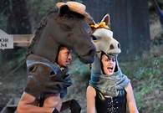
#3 - Code
Computer reads code line-by-line
Each line tells it to do something different
Not always a “right way”
(But some are more right than others)

Slide 9
Hot & Cold code
Write:

Slide 10
Try it!
Refer to the hangman code

Slide 11
Hot & Cold!
Celebrate:

Slide 12
Break
Enjoy:

Slide 13
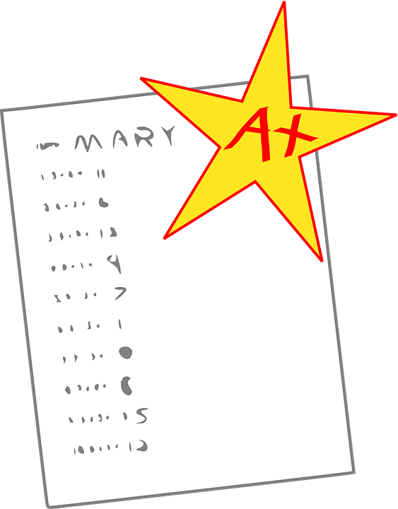
#4 - Test
Bzzrp...
Back to test sets from #1!

Slide 14
Hot & Cold app!
Test:

Slide 15
Personal Project
Learning Experience
Pick things just outside of comfort level
Will present your project on Friday
OR present on an interesting programming concept and demo code

Slide 16
Homework
Start on personal projects!

